Slide 1

32555 – Fundamentals of Software Development

Slide 2
Welcome to 32555 – Fundamentals of Software Development
Your Teaching Team:
Dr. Yining Hu | Subject Coordinator
Yining is a Lecturer in Software Engineering. She works with many SMEs to develop software and AI solutions through student and research projects at UTS.
Contact: yining.hu@uts.edu.au
Dr. Xiaojie (Zoe) Lin | Tutor
Zoe is a full-stack software engineer with an interest in data analysis, specializing in JAVA, R, Python, JavaScript, PHP, Bash, and MATLAB; familiar with AWS.
Contact: Xiaojie.Lin@uts.edu.au
Dr. Farshid Keivanian | Tutor
Dr. Farshid Keivanian is an experienced university lecturer and researcher with a PhD in Information Technology. He has over 15 years of teaching experience across Australian institutions, specialising in software engineering, data science, AI, and cybersecurity.
Contact: Farshid.Keivanian@uts.edu.au
Yong Pov | Tutor
Yong is a full-stack software engineer with experience in React, JavaScript, TypeScript, Java, Python, SQL, and AI-assisted learning platforms.
Contact: Yong.Pov@uts.edu.au

Slide 3
Welcome to 32555 – Fundamentals of Software Development
Cmp1 # | Location | Time | Tutor
01 | CB11.B1.400 | Fri 16:00-18:00 | Xiaojie (Zoe) Lin
07 | CB11.B1.401 | Wed 10:00-12:00 | Farshid Keivanian
08 | CB11.B1.400 | Fri 12:00-14:00 | Yong Pov
09 | CB11.B1.103 | Wed 16:00-18:00 | Farshid Keivanian
10 | CB11.B1.401 | Wed 12:00-14:00 | Farshid Keivanian

Slide 4
Week 3 Outline
Lab 3 Exercises
Object-Oriented Programming (OOP)
Hands-On Activity 1 (CBA_BankAccount_Deposit)
Hands-On Activity 2 (Create Multiple Bank Accounts and Call Their Methods) – Python
Hands-On Activity 3 (OOP Example – Train Class) in Python
Hands-On Activity 4 (Create Your Favourite Aussie Sport Class) in Python
Data Types, Variables, and Operators
Hands-On Activity 5: Data Types, Variables, and Operators
Strings & String Formatting
Arrays
Java Arrays in Eclipse — StationsApp Demo
Array Example in Java (Visual Studio Code)- Necessary Package in Visual Studio Code
Input/Output (I/O)
Input/Output (I/O) – Java Example in Eclipse

Slide 5
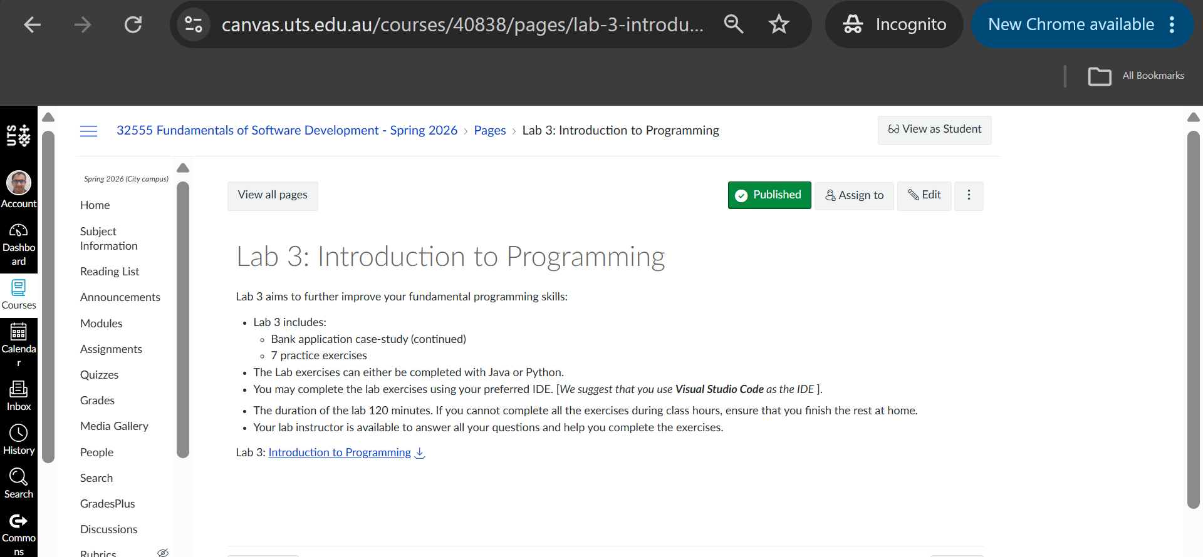
Lab 3 Exercises

Slide 6
Lab 3 exercises lab time: 120 minutes
Lab 3 has two objectives:
Primary: Implement the DeskBankApp [refer to Lab 2 class diagram]
Secondary: Complete the practice exercises [ 1 to 7]
Complete the Lab 3 exercises using either Java or Python.
Recommended IDE for Java and Python: vscode

Slide 7
Lab 3
Case Study: Develop the DeskBankApp system – First Implementation
This exercise is the first implementation of the DeskBankApp case study
1 - Create a main class called Bank
2 - Define main() method in Bank with the following operations:
- make a deposit (read amount from STDIN) and display the amount deposited
- make a withdraw (read amount from STDIN) and display the amount withdrawn
Sample I/O
Amount to deposit $ 200.2
Amount $200.20 deposited
Amount to withdraw $ 50.5
Amount $50.50 withdrawn

Slide 8
Objective
Lab 3 starts turning the UML design from Lab 2 into working code.
For this first implementation, we are not building the entire DeskBankApp yet.
We only need to:
Create a Bank main class.
Read a deposit amount from the keyboard.
Display the deposited amount.
Read a withdrawal amount.
Display the withdrawn amount.

Slide 9
Lab 3 — DeskBankApp: First Implementation
Task
Create the first simple implementation of DeskBankApp.
The program must:
Create a main Bank class.
Start the program.
Read a deposit amount from STDIN.
Display the deposited amount.
Read a withdrawal amount from STDIN.
Display the withdrawn amount.
Format monetary values to 2 decimal places.

Slide 10
What is STDIN?
STDIN = Standard Input
In this exercise, STDIN simply means:
Input entered by the user using the keyboard.

Slide 11
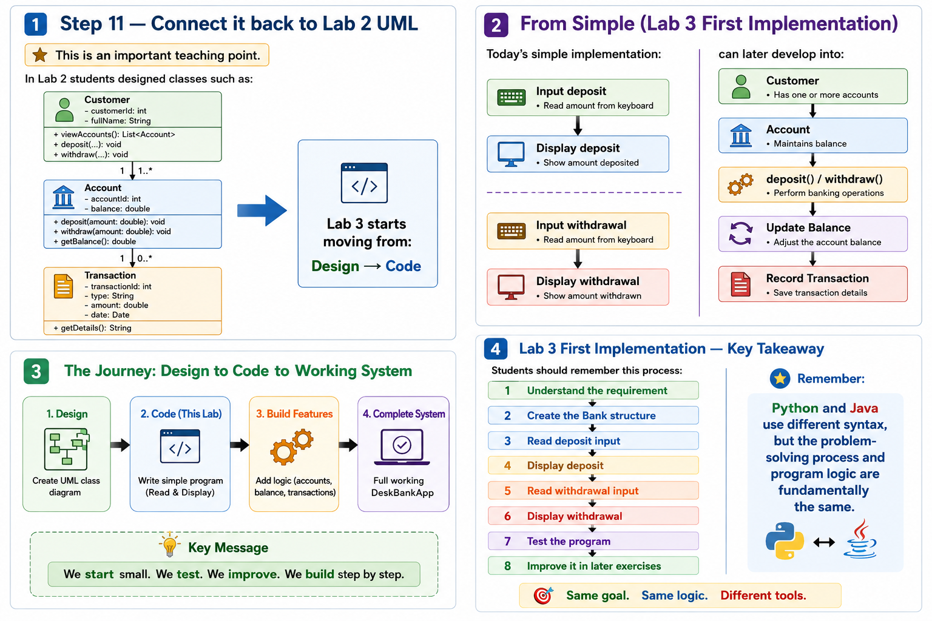

Slide 14
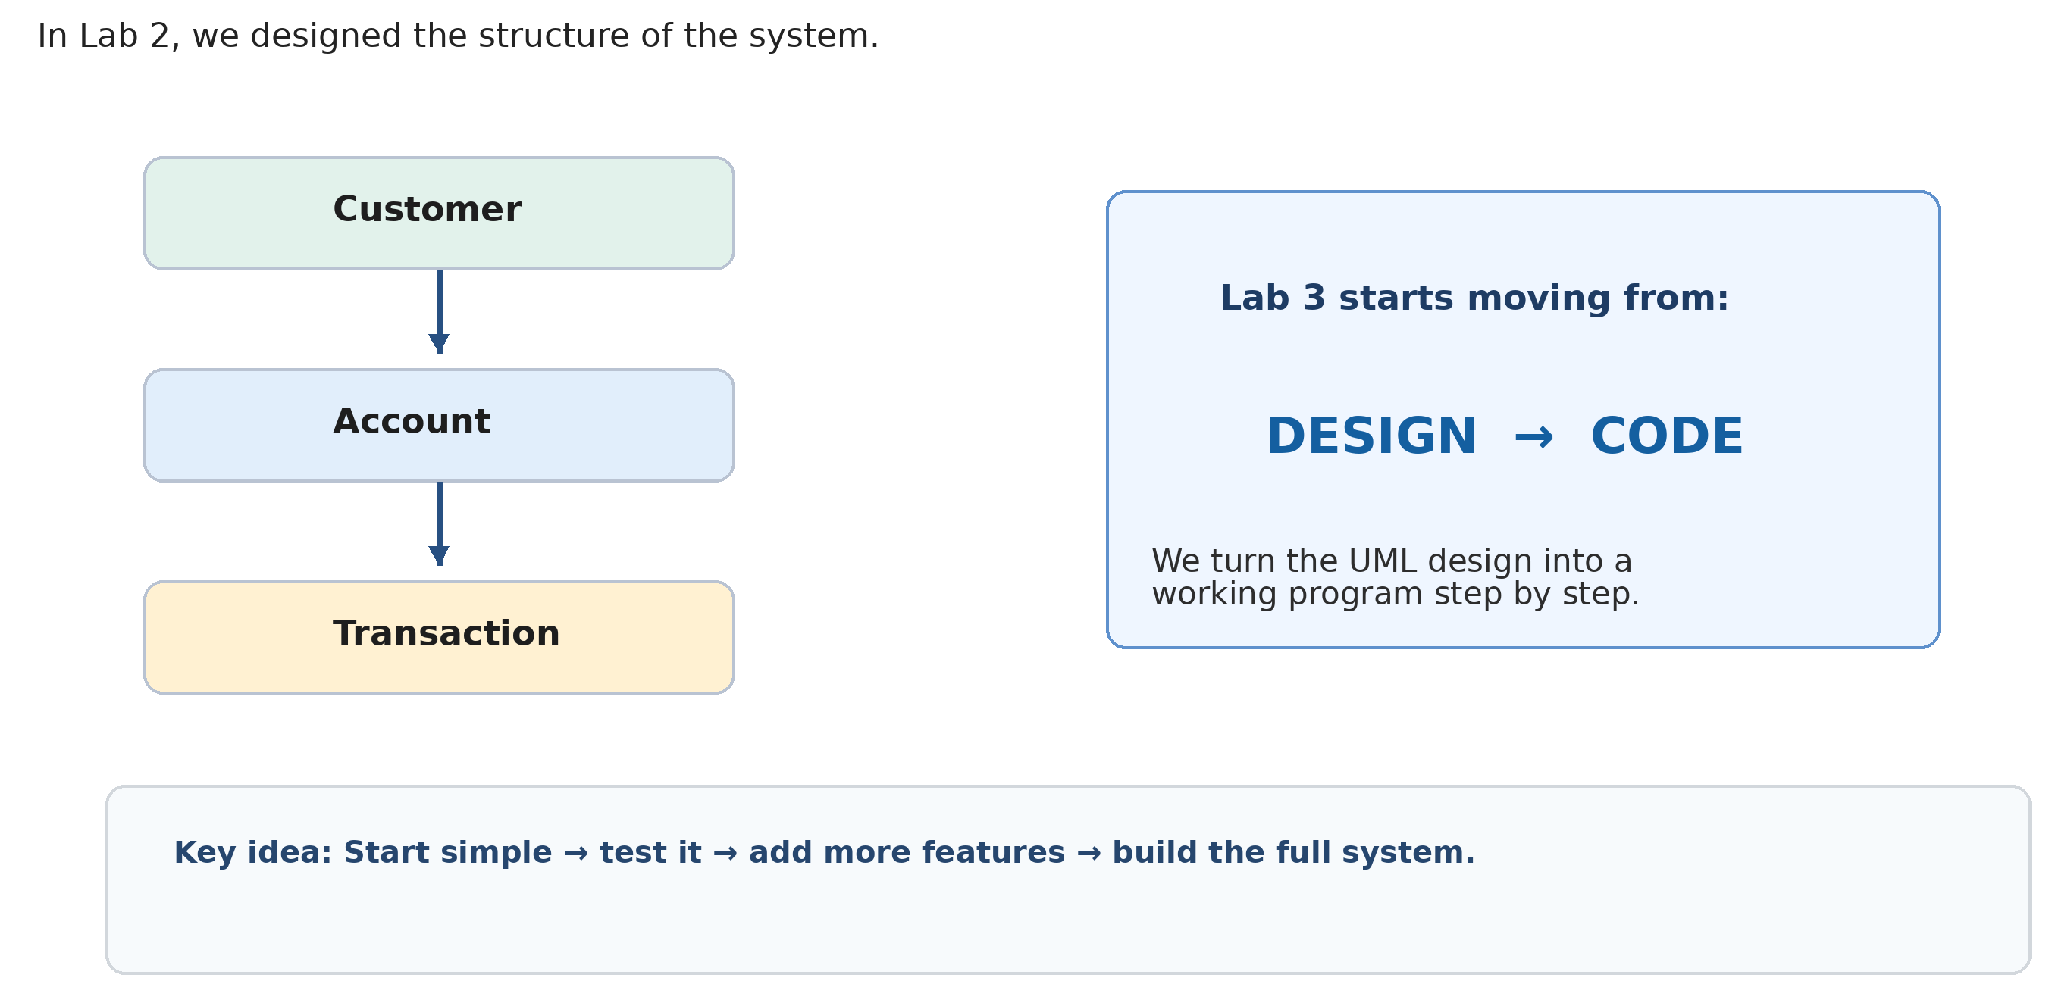
Step 11 — Connect Lab 2 UML to Lab 3 Code

Slide 15
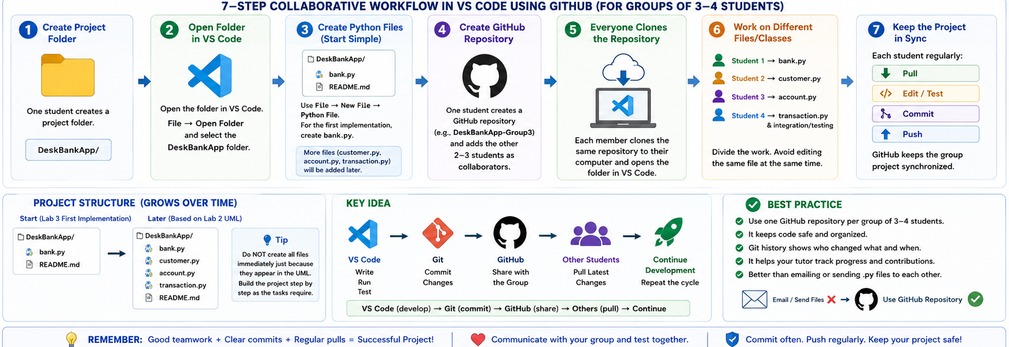
Group Project Workflow in VS Code (Python) Using GitHub

Slide 16
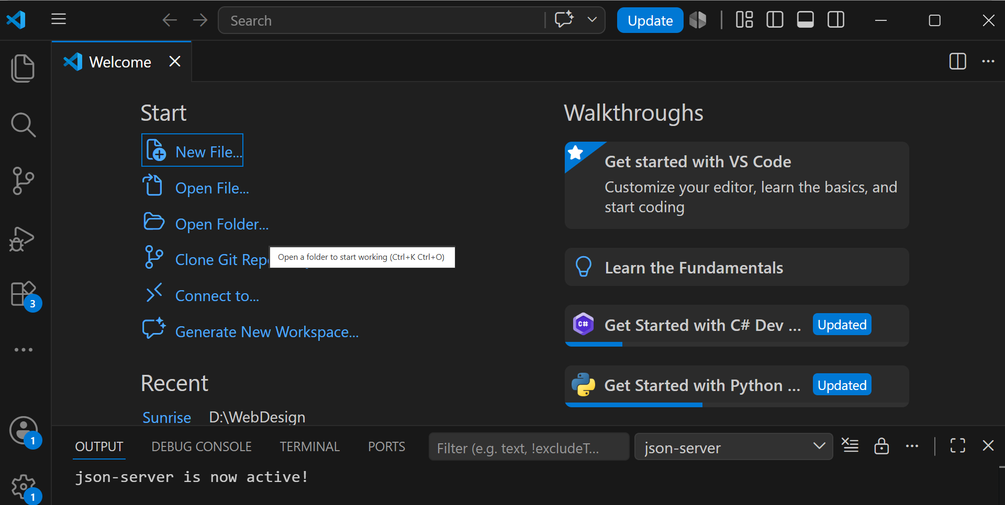
Lab 3 — Group Coding Workflow in VS Code
A simple workflow for your group of 3–4 students is:
One student creates a project folder, for example:
DeskBankApp/
Open the project folder in VS Code:
File → Open Folder → DeskBankApp
Opening the whole folder is important because all program files should belong to the same project.

Slide 17
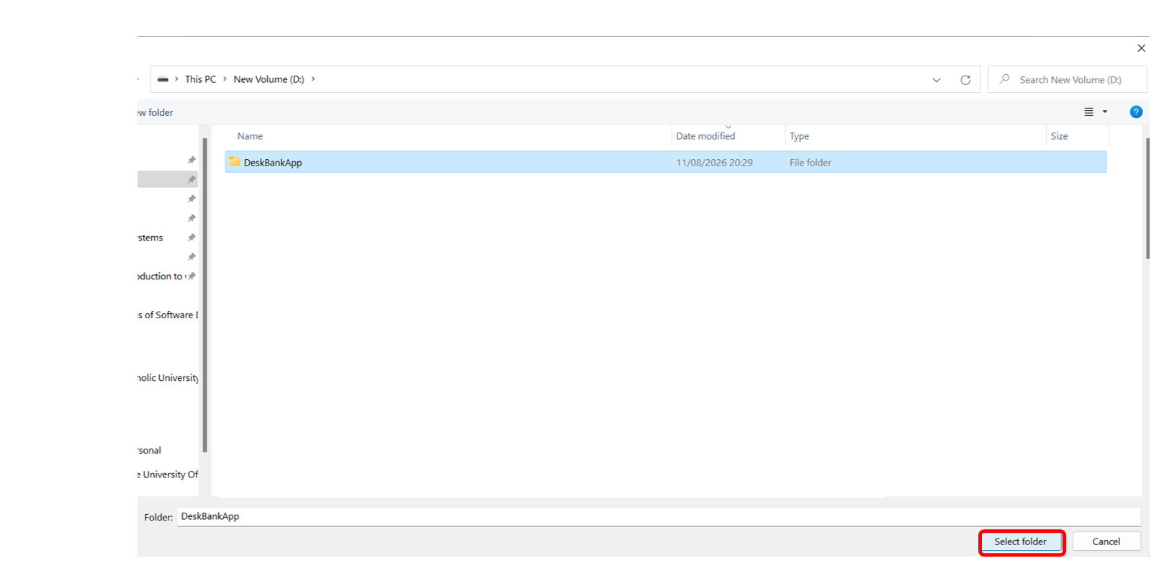

Slide 18
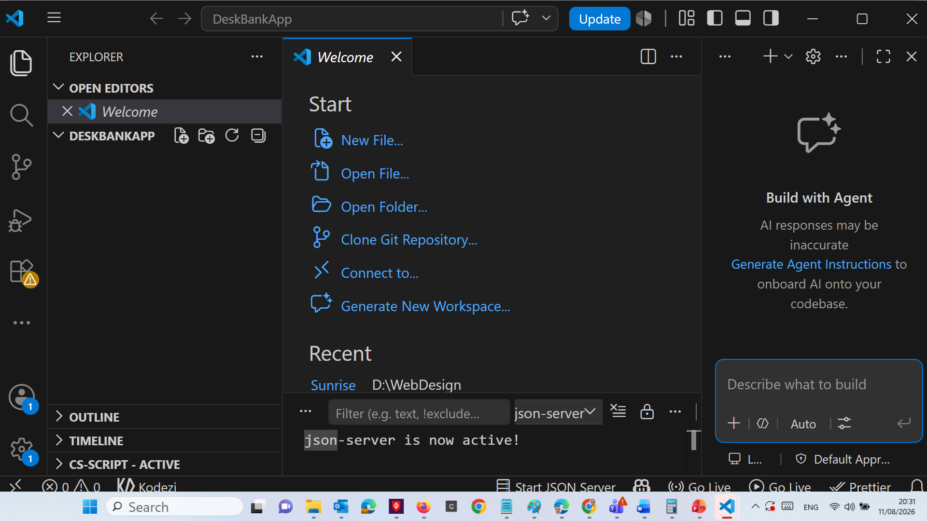

Slide 19
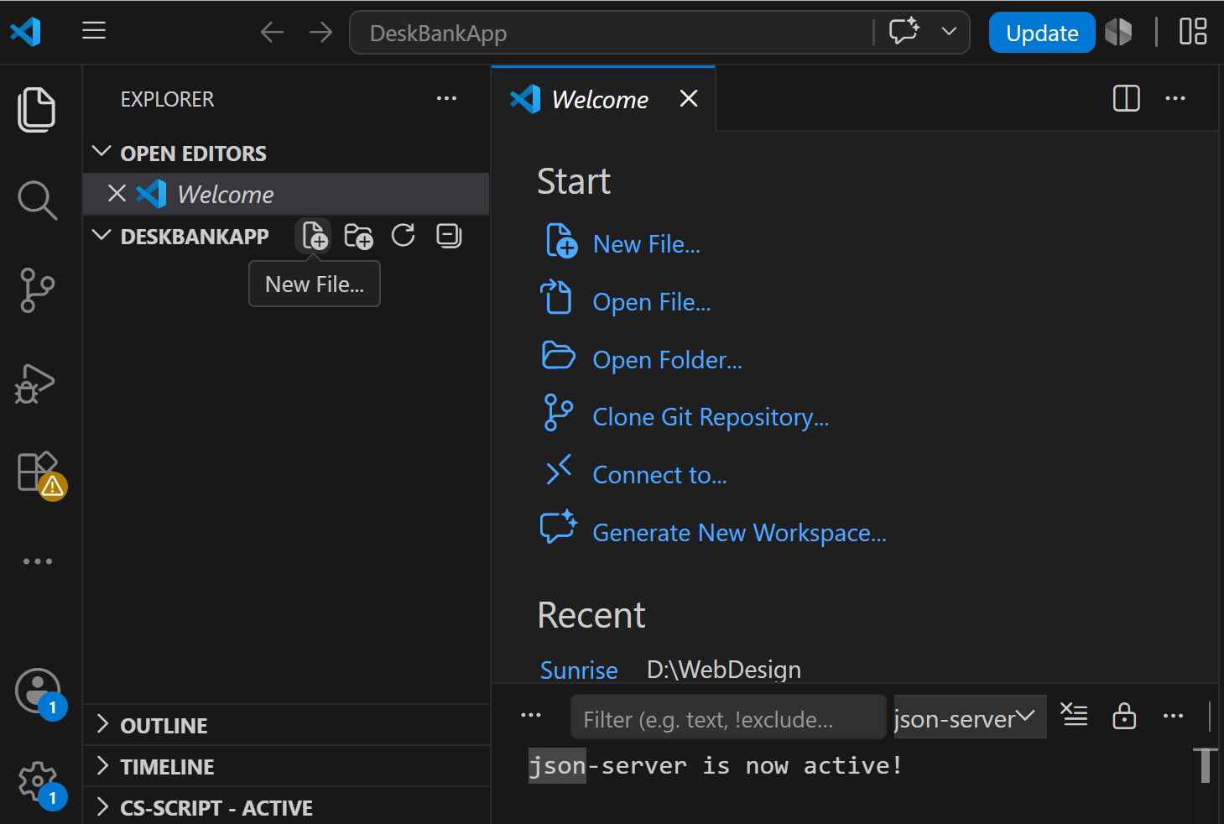

Slide 20
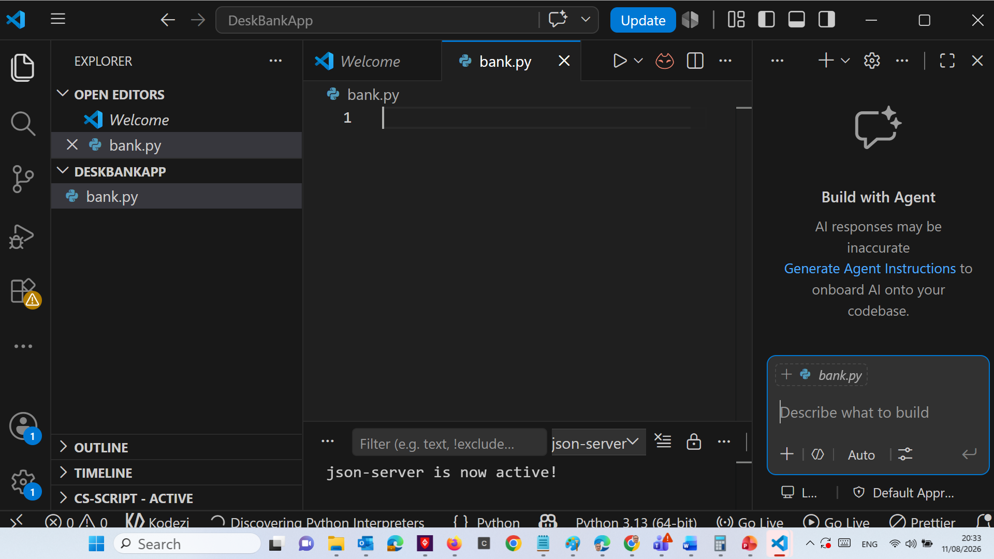

Slide 21
Inside the folder, create the required program files.
For the first implementation, start simply:
DeskBankApp/
├ bank.py
└─ README.md
Use:
File → New File → Python File
and save the file as:
bank.py

Slide 22
As the DeskBankApp is developed further using the Lab 2 UML class design, the project can gradually grow to include files such as:
DeskBankApp/
├ bank.py
├ customer.py
├ account.py
├ transaction.py
└── README.md
Do not create all these classes immediately just because they appear in the UML. For the first Lab 3 implementation, complete the required Bank program first and extend the project as later tasks require.

Slide 23
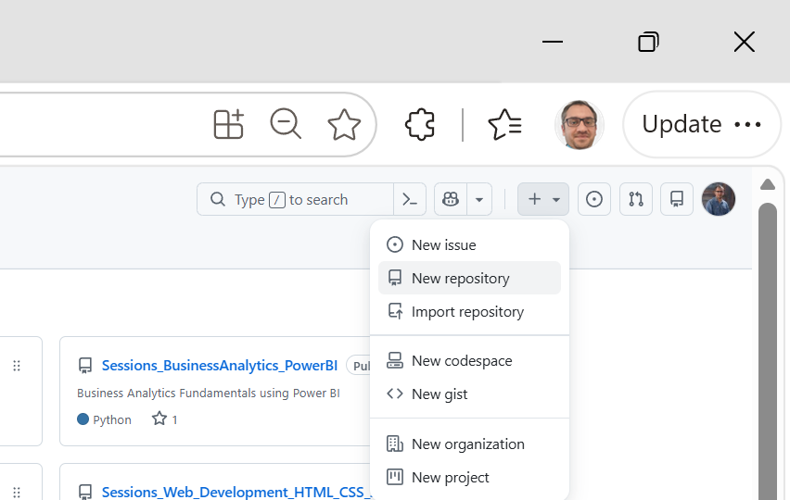
One student creates a GitHub repository for the group, for example:
DeskBankApp-Group3
Add the other 2–3 group members as collaborators.
Each group member clones the same GitHub repository onto their computer and opens the cloned project folder in VS Code.
This means everyone is working with the same group project.
Divide the work between group members as the project develops. For example:
Student 1 → Bank / main program
Student 2 → Customer
Student 3 → Account
Student 4 → Transaction + integration/testing

Slide 24
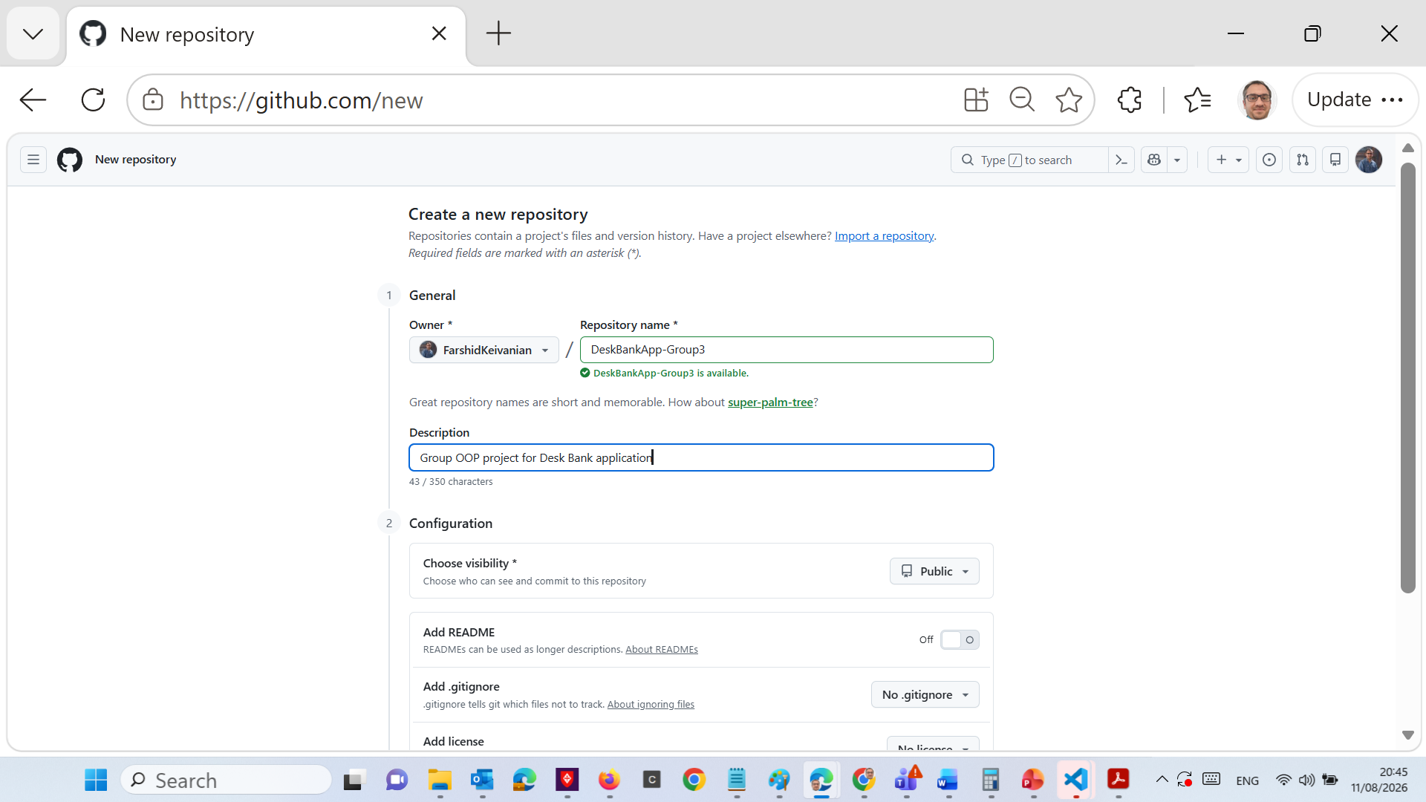

Slide 25
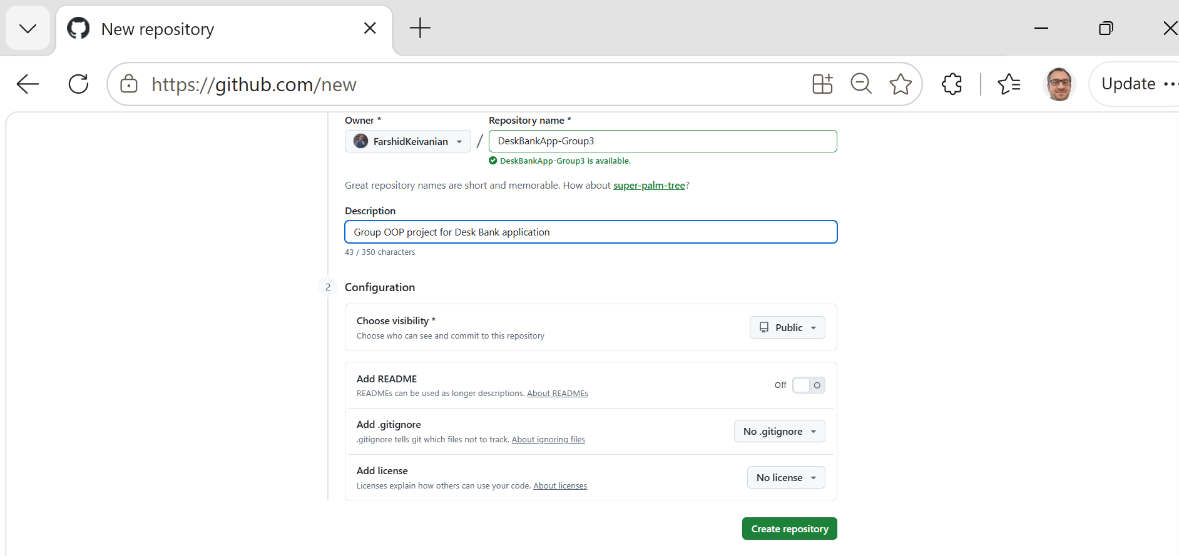

Slide 26
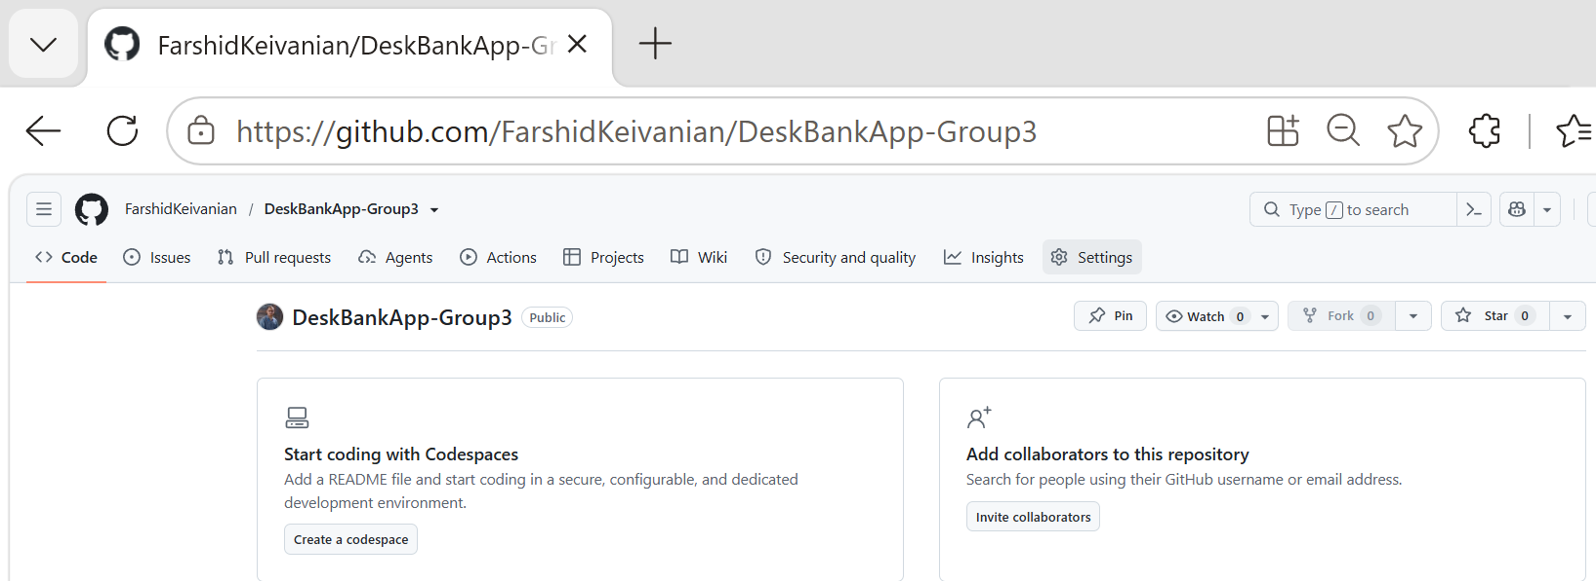
Add group members
Inside the new repository, go to:
Settings → Collaborators → Add people
Suppose the group has four students:
Student 1: Alice
Student 2: Ben
Student 3: Sara
Student 4: John
Add their GitHub usernames. They will need to accept the invitations.
"There is only one GitHub repository for your group. You do not create four separate copies on GitHub."

Slide 27
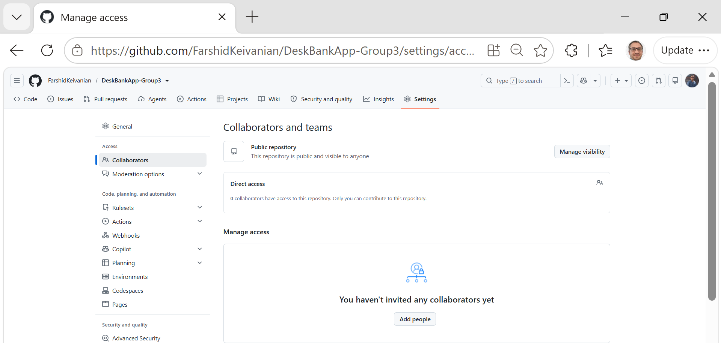
Add group members
Inside the new repository, go to:
Settings → Collaborators → Add people
Suppose the group has four students:
Student 1: Alice
Student 2: Ben
Student 3: Sara
Student 4: John
Add their GitHub usernames. They will need to accept the invitations.
"There is only one GitHub repository for your group. You do not create four separate copies on GitHub."

Slide 28
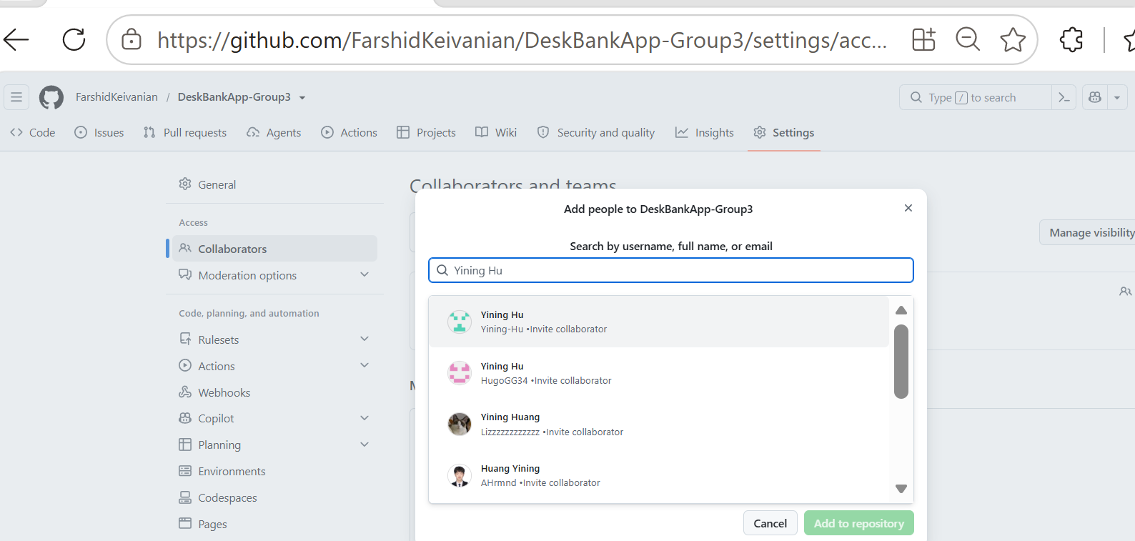
Add group members
Inside the new repository, go to:
Settings → Collaborators → Add people
Suppose the group has four students:
Student 1: Alice
Student 2: Ben
Student 3: Sara
Student 4: John
Add their GitHub usernames. They will need to accept the invitations.
"There is only one GitHub repository for your group. You do not create four separate copies on GitHub."

Slide 29
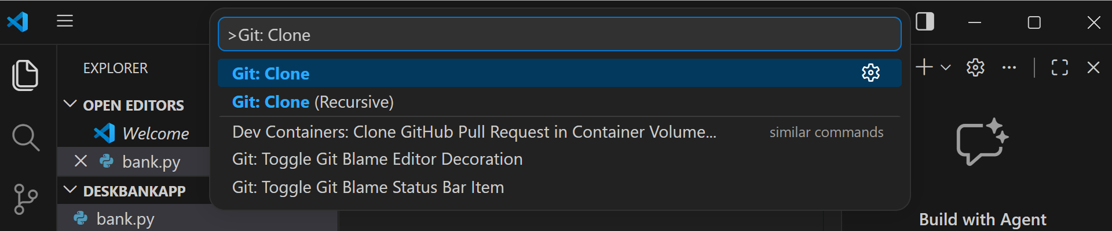
Clone the repository into VS Code
In VS Code press:
Ctrl + Shift + P
Type:
Git: Clone
Select:
Git: Clone
Paste the repository URL from GitHub, choose where to save it, and then select:
Open
The Explorer should now show:
DESKBANKAPP-GROUP3
Now the local VS Code project is connected to the group's GitHub repository.

Slide 30
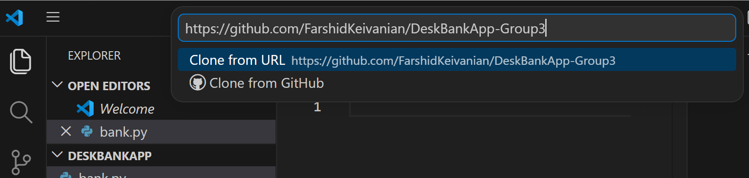
Clone the repository into VS Code
In VS Code press:
Ctrl + Shift + P
Type:
Git: Clone
Select:
Git: Clone
Paste the repository URL from GitHub, choose where to save it, and then select:
Open
The Explorer should now show:
DESKBANKAPP-GROUP3
Now the local VS Code project is connected to the group's GitHub repository.

Slide 31
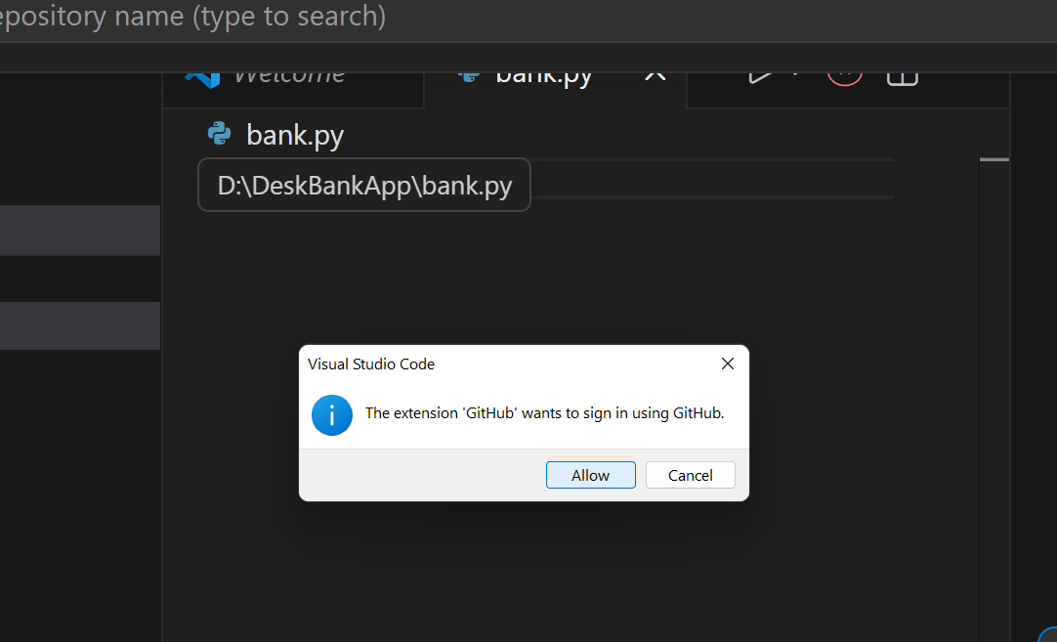
Clone the repository into VS Code
In VS Code press:
Ctrl + Shift + P
Type:
Git: Clone
Select:
Git: Clone
Paste the repository URL from GitHub, choose where to save it, and then select:
Open
The Explorer should now show:
DESKBANKAPP-GROUP3
Now the local VS Code project is connected to the group's GitHub repository.

Slide 32
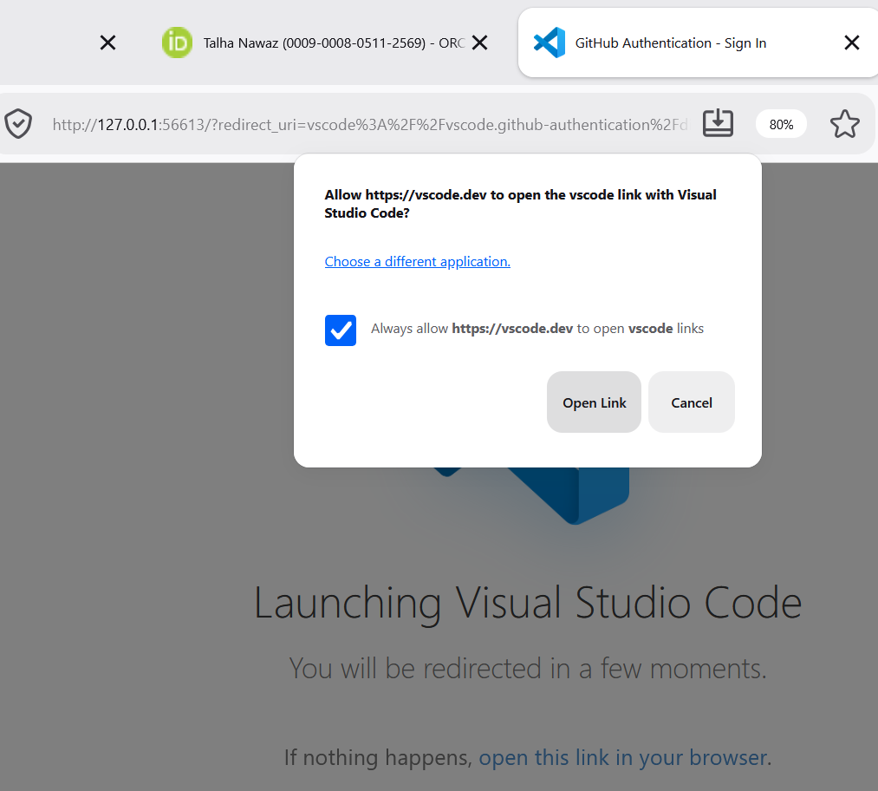
Clone the repository into VS Code
In VS Code press:
Ctrl + Shift + P
Type:
Git: Clone
Select:
Git: Clone
Paste the repository URL from GitHub, choose where to save it, and then select:
Open
The Explorer should now show:
DESKBANKAPP-GROUP3
Now the local VS Code project is connected to the group's GitHub repository.

Slide 33
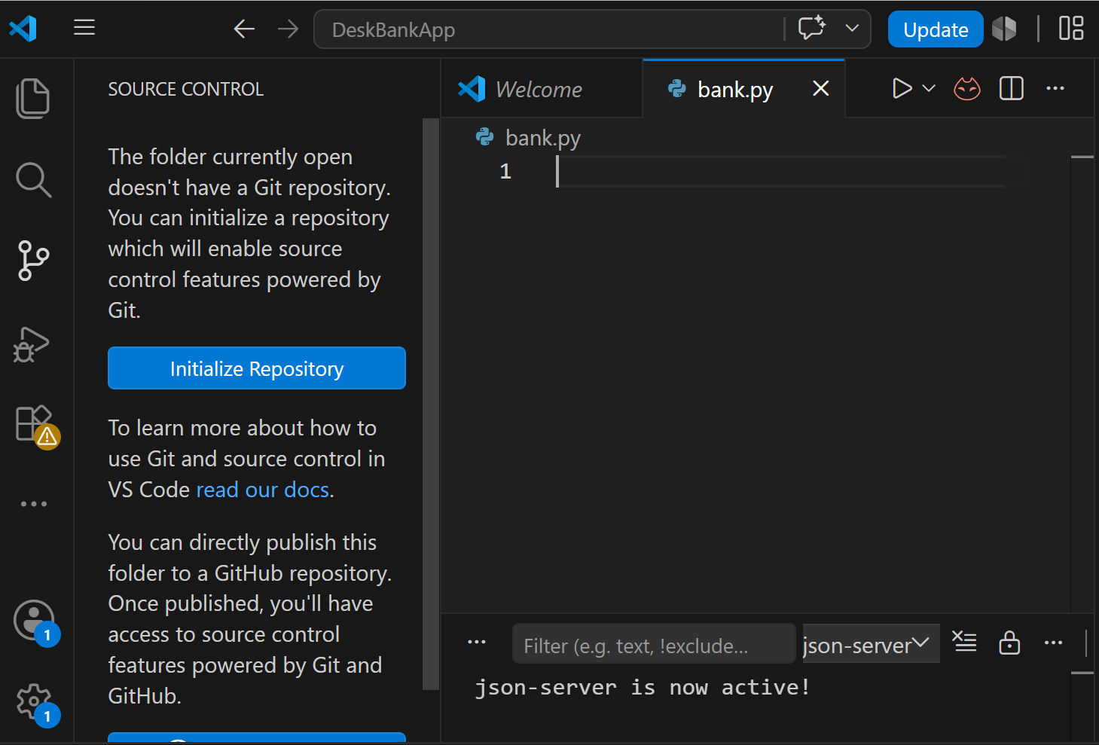
Create the first Python program
Inside the cloned project folder, create:
bank.py
This gives you a very small OOP example before writing multiple classes.

Slide 34
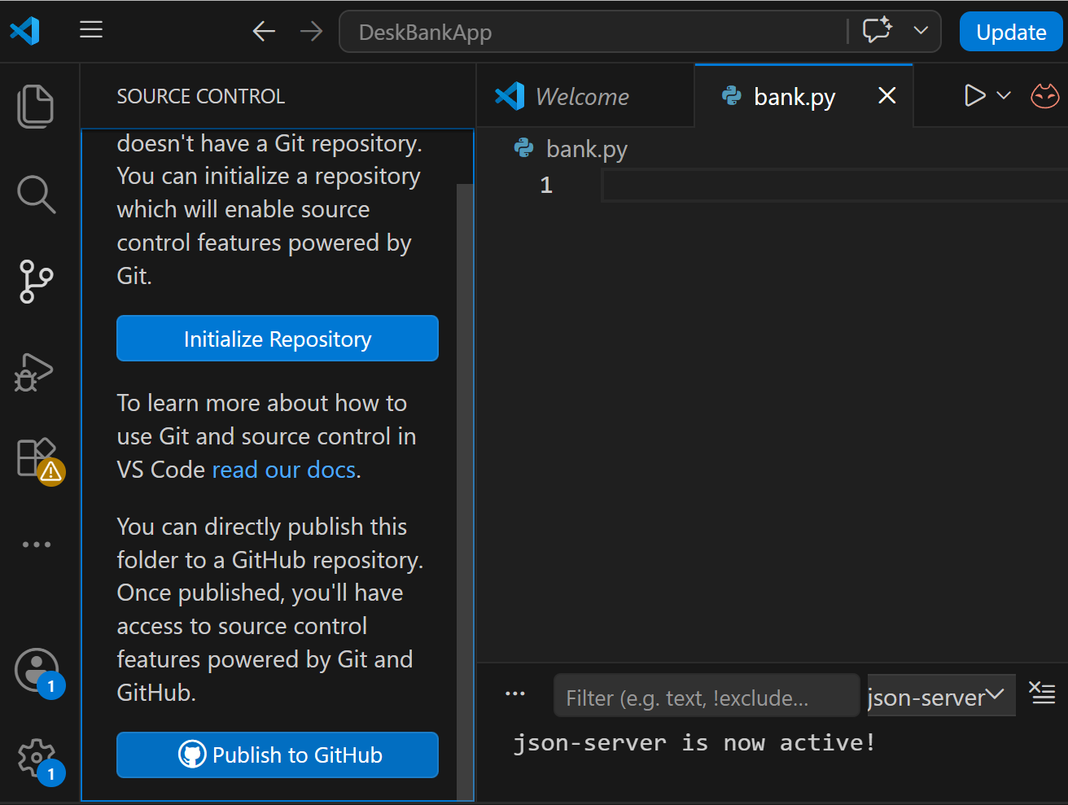
CTRL + SHIFT + G Then select Commit and Push/Sync Changes.
Return to GitHub and refresh DeskBankApp-Group3.
Students will see:
DeskBankApp-Group3
└── bank.py
This is a useful point in the demonstration because you can physically see that the code written in VS Code has appeared on GitHub.

Slide 35
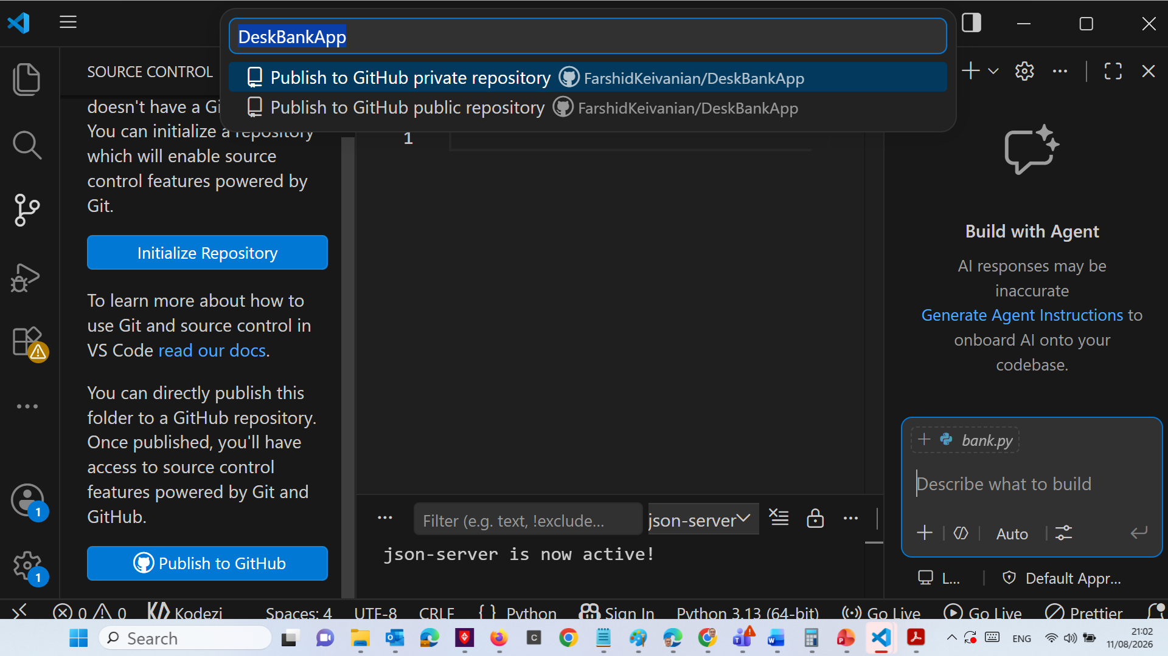

Slide 36
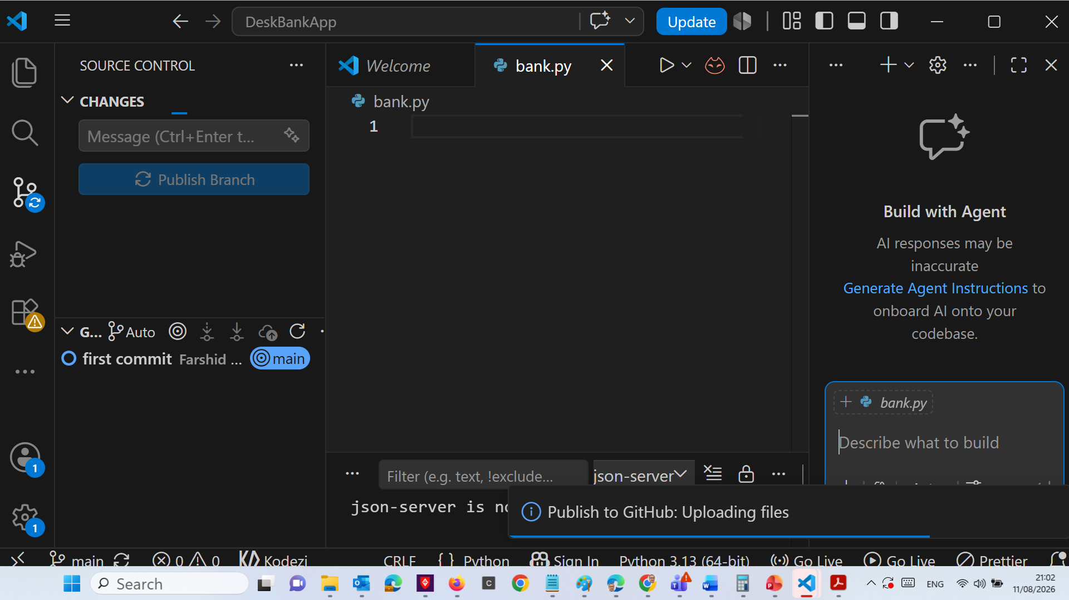

Slide 37
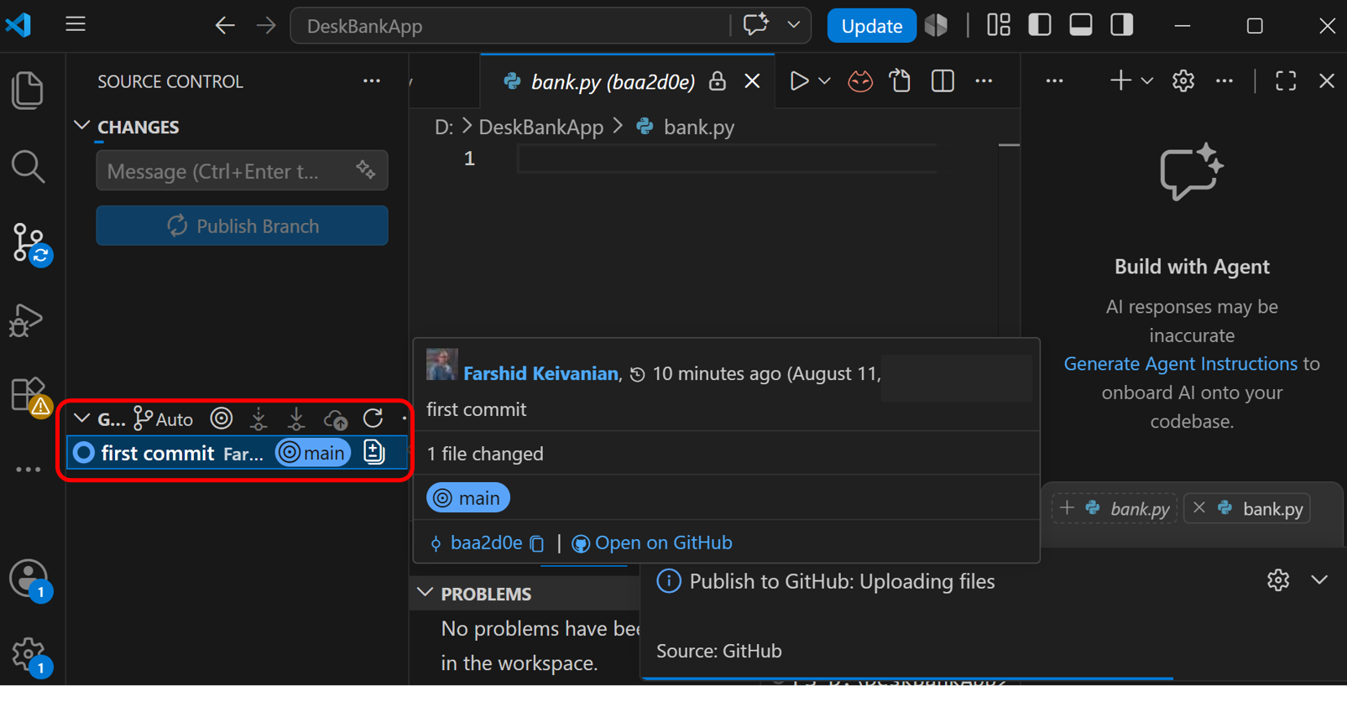

Slide 38
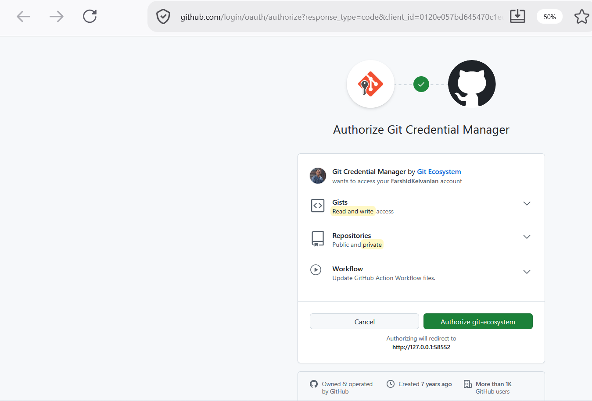

Slide 39
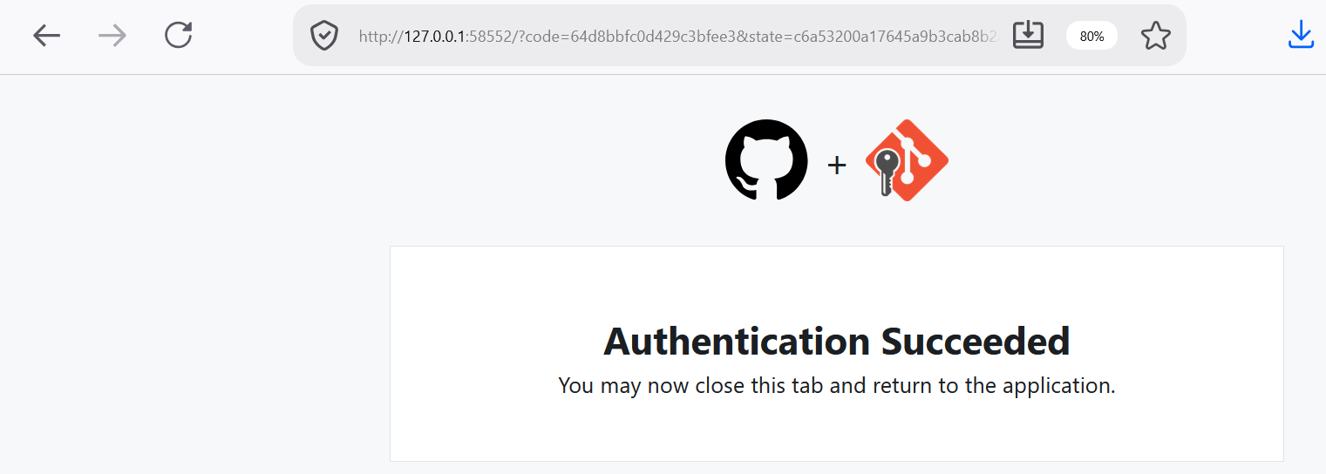

Slide 40
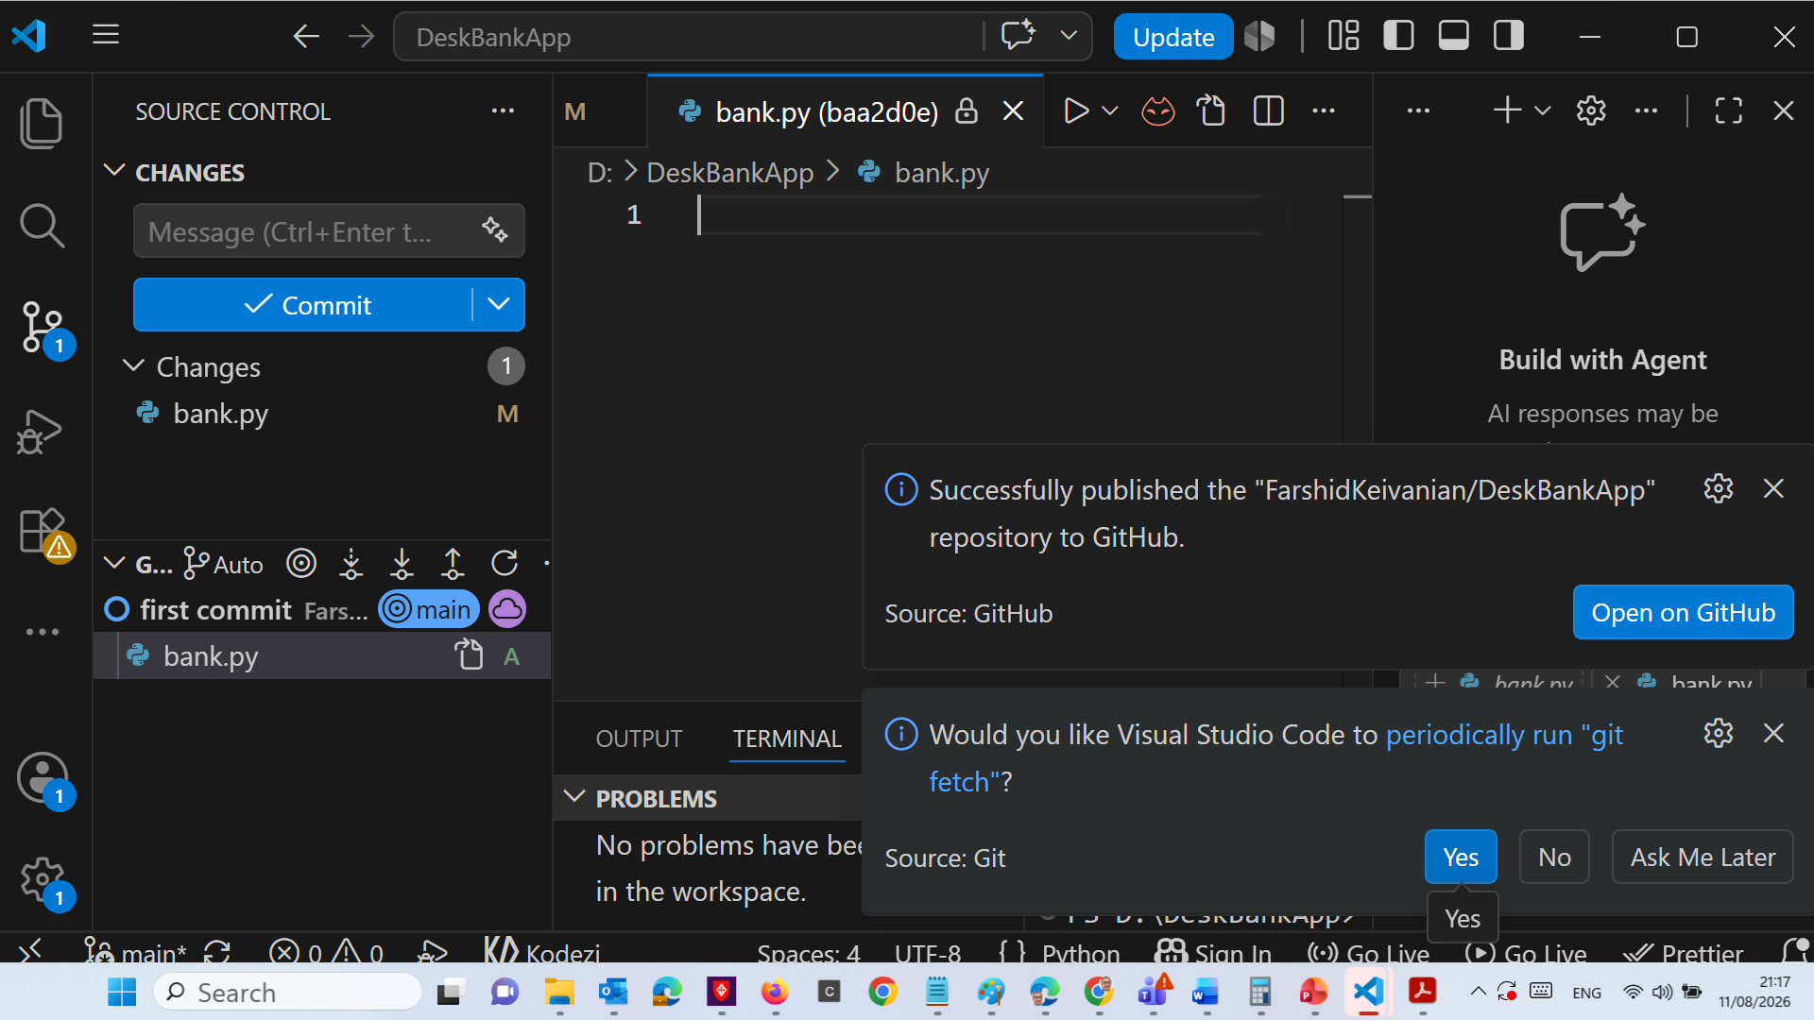

Slide 41
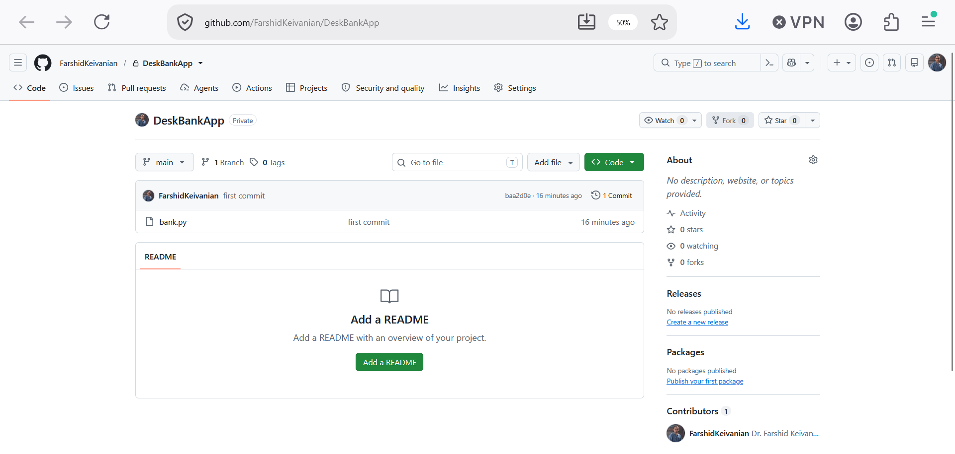

Slide 42
Demonstrate what another student does
"Now imagine I am Student 2."
Student 2 does not create another repository.
They clone:
DeskBankApp-Group3
Then they can add another class, for example:
customer.py
Their commit could be:
Added Customer class
and they push it.
Now GitHub contains:
DeskBankApp-Group3/
│
├ bank.py
└─ customer.py

Slide 43
Show how the project grows
Later, the four-person project might look like:
DeskBankApp-Group3/
│
├ main.py
├ bank.py
├ customer.py
├ account.py
├ transaction.py
└─ README.md
The responsibilities could be:
Student 1 → bank.py + main.py
Student 2 → customer.py
Student 3 → account.py
Student 4 → transaction.py + testing
This is where the advantage of OOP becomes very clear: different students can develop different classes while contributing to the same application.

Slide 44
For the first implementation, because the task is small, students should work together to understand and test the Bank program rather than artificially creating unnecessary classes.
Before making changes, each student should get the latest version from GitHub. A simple routine is:
Pull → Edit / Write Code → Run and Test → Commit → Push
Use clear commit messages so the group member can understand what was changed:
Created Bank program
Added deposit input
Added withdrawal input
Formatted amounts to two decimal places
Tested deposit and withdrawal

Slide 45
Avoid editing the same file at the same time where possible. As the project becomes larger, divide the classes/files among group members and then integrate and test the complete application together.
Key idea for students
VS Code is where you write, run, and test the code.
GitHub is where your group shares and synchronises the project and records contributions.
So:
VS Code) Write + Run + Test → Git Commit changes → GitHub
Share with the group → Other students Pull → Continue development
For Lab 3, I recommend one GitHub repository per group of 3–4 students. This is much better than emailing or sending .py files to each other, and the Git history also provides useful evidence of each student's contribution.

Slide 46
Step 1 — Create the Bank class
Start with the smallest possible program structure.
Python
class Bank:
pass
Explanation
class Bank:
creates a class called Bank.
pass
means:
The class is currently empty, but Python accepts it.

Slide 47
Java
public class Bank {
}
Explanation
public class Bank
creates a Java class called Bank.
For Java, save the file as:
Bank.java

Slide 48
Step 2 — Add the program starting point
Now we need somewhere for the program to start.
Python
class Bank:
@staticmethod
def main():
print("DeskBankApp started")
Bank.main()
Explanation
def main():
defines the main() method.
Bank.main()
calls the method and starts our program.
Python does not require a main() method, but we are using one here so that the program structure is similar to Java.

Slide 49
Java
public class Bank {
public static void main(String[] args) {
System.out.println("DeskBankApp started");
}
}
Explanation
public static void main(String[] args)
is the standard starting point of a Java application.
When Java runs Bank, execution begins inside main().

Slide 50
Step 3 — Ask the user for a deposit amount
Now we need keyboard input.
Python
Python has a built-in input() function.
class Bank:
@staticmethod
def main():
deposit_amount = float(
input("Amount to deposit $ ")
)
Bank.main()
Explanation
input("Amount to deposit $ ")
displays the message and waits for the user to type something.
If the user enters:
200.2
input() initially reads it as text.
Therefore we use:
float(...)
to convert it into a decimal number.
The result is stored in:
deposit_amount

Slide 51
Java
Java uses Scanner to read keyboard input.
import java.util.Scanner;
public class Bank {
public static void main(String[] args) {
Scanner input = new Scanner(System.in);
System.out.print("Amount to deposit $ ");
double depositAmount = input.nextDouble();
}
}
Explanation
First:
import java.util.Scanner;
allows us to use Java's Scanner class.
Then:
Scanner input = new Scanner(System.in);
creates a Scanner that reads from the keyboard.
double depositAmount = input.nextDouble();
reads a decimal number and stores it in depositAmount.

Slide 52
Step 4 — Display the deposited amount
The requirement says the deposited amount should be displayed.
It should have exactly two decimal places.
Python
Add:
print(f"Amount ${deposit_amount:.2f} deposited")
Our program is now:
class Bank:
@staticmethod
def main():
deposit_amount = float(
input("Amount to deposit $ ")
)
print(
f"Amount ${deposit_amount:.2f} deposited"
)
Bank.main()

Slide 53
What does .2f mean?
:.2f
means:
Display the floating-point number using exactly 2 decimal places.
For example:
200.2
becomes:
200.20

Slide 54
Java
Add:
System.out.printf(
"Amount $%.2f deposited%n",
depositAmount
);
Program so far:
import java.util.Scanner;
public class Bank {
public static void main(String[] args) {
Scanner input = new Scanner(System.in);
System.out.print("Amount to deposit $ ");
double depositAmount = input.nextDouble();
System.out.printf(
"Amount $%.2f deposited%n",
depositAmount
);
}
}

Slide 55
What does %.2f mean?
%.2f
means:
Display a decimal number using exactly 2 decimal places.
And:
%n
moves the output to the next line.

Slide 56
Full program so far:
class Bank:
@staticmethod
def main():
deposit_amount = float(
input("Amount to deposit $ ")
)
print(
f"Amount ${deposit_amount:.2f} deposited"
)
withdraw_amount = float(
input("Amount to withdraw $ ")
)
Bank.main()
Step 5 — Ask for the withdrawal amount
We now repeat the same idea for a withdrawal.
Python
withdraw_amount = float(
input("Amount to withdraw $ ")
)

Slide 57
Java
Add:
System.out.print("Amount to withdraw $ ");
double withdrawAmount = input.nextDouble();
Program so far:
import java.util.Scanner;
public class Bank {
public static void main(String[] args) {
Scanner input = new Scanner(System.in);
System.out.print("Amount to deposit $ ");
double depositAmount = input.nextDouble();
System.out.printf(
"Amount $%.2f deposited%n",
depositAmount
);
System.out.print("Amount to withdraw $ ");
double withdrawAmount = input.nextDouble();
}
}

Slide 58
Step 6 — Display the withdrawn amount
Now display the withdrawal using two decimal places.
Python
print(
f"Amount ${withdraw_amount:.2f} withdrawn"
)
Completed logic:
class Bank:
@staticmethod
def main():
deposit_amount = float(input("Amount to deposit $ "))
print(f"Amount ${deposit_amount:.2f} deposited")
withdraw_amount = float(input("Amount to withdraw $ "))
print(f"Amount ${withdraw_amount:.2f} withdrawn")
Bank.main()

Slide 59
Java
Add:
System.out.printf(
"Amount $%.2f withdrawn%n",
withdrawAmount
);
Program:
import java.util.Scanner;
public class Bank {
public static void main(String[] args) {
Scanner input = new Scanner(System.in);
System.out.print("Amount to deposit $ ");
double depositAmount = input.nextDouble();
System.out.printf(
"Amount $%.2f deposited%n",
depositAmount
);
System.out.print("Amount to withdraw $ ");
double withdrawAmount = input.nextDouble();
System.out.printf(
"Amount $%.2f withdrawn%n",
withdrawAmount
);
}
}

Slide 60
Step 7 — Finish the program properly
Python — Final Version
class Bank:
@staticmethod
def main():
# Read deposit amount
deposit_amount = float(
input("Amount to deposit $ ")
)
# Display deposited amount
print(
f"Amount ${deposit_amount:.2f} deposited"
)
# Read withdrawal amount
withdraw_amount = float(
input("Amount to withdraw $ ")
)
# Display withdrawn amount
print(
f"Amount ${withdraw_amount:.2f} withdrawn"
)
if __name__ == "__main__":
Bank.main()
What does this mean?
if __name__ == "__main__":
means:
Run the following code when this Python file is executed directly.
Then:
Bank.main()
starts our banking program.
It is the standard Python way of controlling where a program starts.

Slide 61
Java — Final Version) We should close the Scanner when finished.
import java.util.Scanner;
public class Bank {
public static void main(String[] args) {
Scanner input = new Scanner(System.in);
// Read deposit amount
System.out.print("Amount to deposit $ ");
double depositAmount = input.nextDouble();
// Display deposited amount
System.out.printf(
"Amount $%.2f deposited%n",
depositAmount
);
// Read withdrawal amount
System.out.print("Amount to withdraw $ ");
double withdrawAmount = input.nextDouble();
// Display withdrawn amount
System.out.printf(
"Amount $%.2f withdrawn%n",
withdrawAmount
);
input.close();
}
}
Why do we use this?
input.close();
We have finished reading keyboard input, so we close the Scanner.

Slide 62
Step 8 — Test the program
Students should test the program using the values from the lab.
Python) Run the program and enter:
200.2
and then:
50.5
Result:
Amount to deposit $ 200.2
Amount $200.20 deposited
Amount to withdraw $ 50.5
Amount $50.50 withdrawn

Slide 63
Java
Use the same input:
Amount to deposit $ 200.2
Amount $200.20 deposited
Amount to withdraw $ 50.5
Amount $50.50 withdrawn
The Python and Java versions should therefore produce essentially the same user experience.

Slide 64
Step 9 — Compare Python and Java
This is a useful discussion slide after completing the program.
Task | Python | Java
Create class | class Bank: | public class Bank
Main method | def main(): | public static void main(...)
Keyboard input | input() | Scanner
Decimal type | float | double
Convert input | float(...) | nextDouble()
Print output | print() | System.out.print()
Formatted output | :.2f | %.2f

Slide 65
Key idea
Although the syntax looks different:
The programming logic is the same.

Slide 66
Step 10 — What has the program actually implemented?
Have we now created a complete banking system?
No. At this stage, the program only performs:
Keyboard Input → Store the number → Display the number
For example: 200.2 → depositAmount → Amount $200.20 deposited

Slide 67
The program does not yet
maintain an account balance
check whether enough money exists before withdrawal
create Customer objects
create Account objects
record transactions
save information to files
provide a CLI menu
provide a GUI
Those features can be introduced gradually.

Slide 68
Short Student Q&A
Q1. Why do we use float in Python and double in Java?
Because the amount may contain decimal values, such as $200.20.
Q2. Why don't we use an integer?
An integer cannot directly represent values such as 50.75.
Q3. What does STDIN mean?
Standard Input—the information entered through the keyboard in this exercise.
Q4. Why do we use two decimal places?
Money is normally displayed using two decimal places.

Slide 69
Q5. What does .2f mean in Python?
Display a floating-point value to two decimal places.
Q6. What does %.2f mean in Java?
It also displays a floating-point value to two decimal places.
Q7. Does the current program actually deposit money into an account?
No. It currently reads and displays the amount only.
Q8. Why are we starting with such a simple program?
Because good software is normally developed incrementally: start with a small working solution, test it, and then add more functionality.

Slide 70
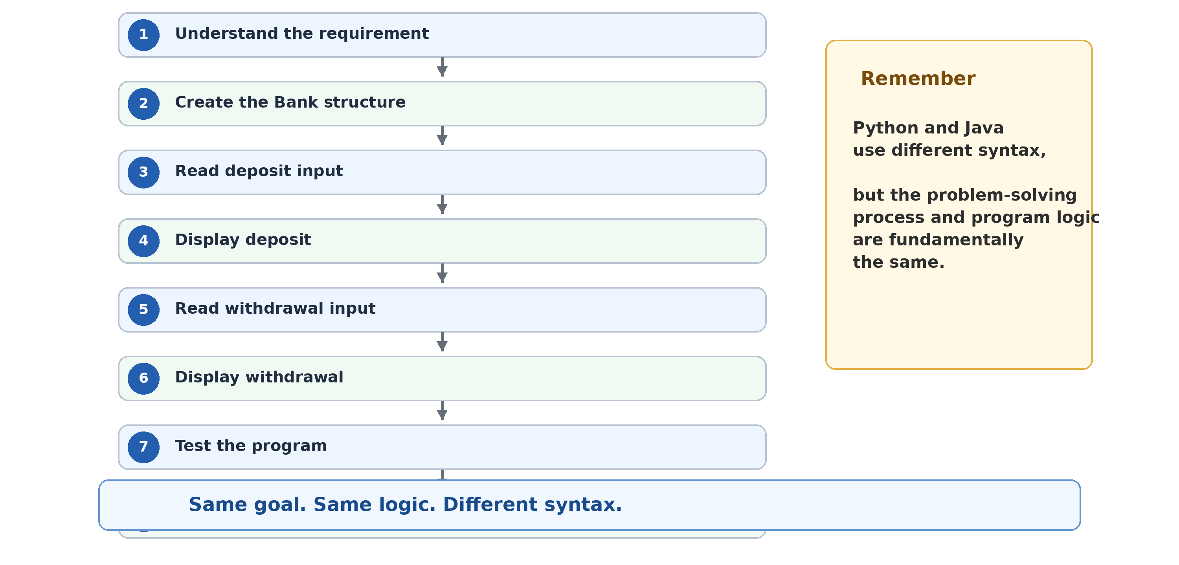
Lab 3 Key Takeaways

Slide 71
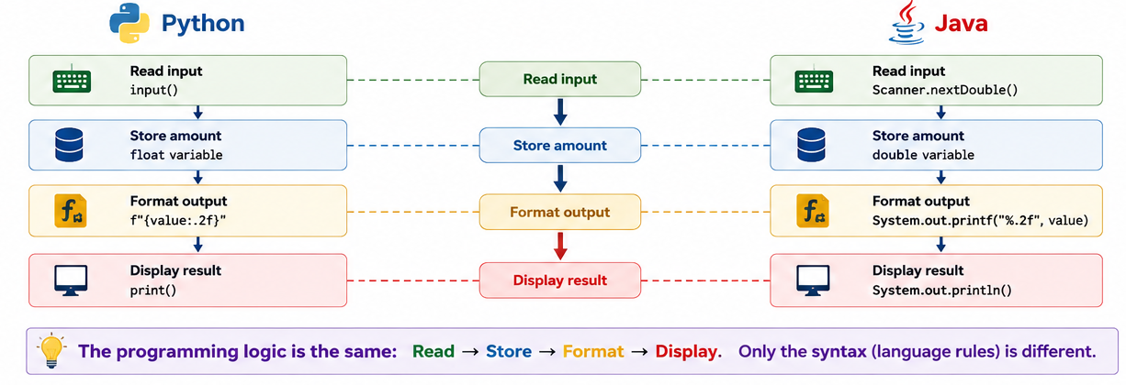
Lab 3 Key Takeaways

Slide 72
Lab 3 Exercises
Exercise: Write a program to initialize two variables x to 4 and y to 2. Then print out the results of the following operations (format each result to 3 decimal points and print each result on a new line).
x + y
x - y
x / y
x * y
x % y + x / y
(y⁷ + 7/(√5 +x)) * (x⁴ % 5 + 2)

Slide 73
Lab 3 Exercises
Exercise: Write a program that completes the following operations:
Read in the integer values of x and y from STDIN
declare a variable z, and assign the result of x to the power of y to it
declare a variable called ‘result’ and assign the square-root of z to it
print the above results each on a new line (formatted to 2 decimal points)

Slide 74
Powers and Square Roots
What are we trying to do?
The program should:
Read integer x.
Read integer y.
Calculate xy and store it in z.
Calculate z​ and store it in result.
Print z and result to 2 decimal places.

Slide 75
For example, if:
x = 4
y = 2
then:
z = 4² = 16
result = √16 = 4
Python)
Step 1 — Start with the basic input
x = int(input("Enter x: "))
y = int(input("Enter y: "))
input() reads what the user types.
int() converts the input to an integer.

Slide 76
Step 2 — Calculate x to the power of y
Python uses ** for powers:
z = x ** y
For example:
4 ** 2 = 16
Step 3 — Calculate the square root
First import the math module:
import math
Then:
result = math.sqrt(z)

Slide 77
Step 4 — Format the output
print(f"{z:.2f}")
print(f"{result:.2f}")
.2f means 2 decimal places.
Step 5 — Completed Python solution
import math
x = int(input("Enter x: "))
y = int(input("Enter y: "))
z = x ** y
result = math.sqrt(z)
print(f"{z:.2f}")
print(f"{result:.2f}")
Example:
Enter x: 4
Enter y: 2
16.00
4.00

Slide 78
JAVA) Step 1 — Create the program
import java.util.Scanner;
public class Exercise2 {
public static void main(String[] args) {
Scanner input = new Scanner(System.in);
}
}
Step 2 — Read x and y
System.out.print("Enter x: ");
int x = input.nextInt();
System.out.print("Enter y: ");
int y = input.nextInt();

Slide 79
Step 3 — Calculate the power
Java uses Math.pow():
double z = Math.pow(x, y);
Remember:
x ^ y
does not mean power in Java.
Step 4 — Calculate the square root
double result = Math.sqrt(z);
Step 5 — Print to 2 decimal places
System.out.printf("%.2f%n", z);
System.out.printf("%.2f%n", result);

Slide 80
Step 6 — Completed Java solution
import java.util.Scanner;
public class Exercise2 {
public static void main(String[] args) {
Scanner input = new Scanner(System.in);
System.out.print("Enter x: ");
int x = input.nextInt();
System.out.print("Enter y: ");
int y = input.nextInt();
double z = Math.pow(x, y);
double result = Math.sqrt(z);
System.out.printf("%.2f%n", z);
System.out.printf("%.2f%n", result);
input.close();
}
}
Q: What is the difference between Math.pow() and Math.sqrt()?
Math.pow() calculates a power, while Math.sqrt() calculates a square root.

Slide 81
Lab 3 Exercises
Exercise: Write a program that outputs the following and determines the area and volume:
Enter circle radius: r
Circumference of radius “value of radius” is: circumference
Circle area of radius “value of radius” is: area
Sphere volume of radius “value of radius” is: volume
NOTE: The value of the radius must be printed between double quotes
NOTE: all values should be formatted to 2 decimal points

Slide 82
Circle and Sphere Calculations
What are we trying to calculate?
For radius r:
Circumference=2πr Area=πr^2 Volume=4/3​πr^3
The radius must also appear inside double quotation marks in the output.
Python
Step 1 — Import math and read the radius
import math
r = float(input("Enter circle radius: "))
We use float because the radius might be:
2.5

Slide 83
Step 2 — Calculate circumference
circumference = 2 * math.pi * r
Step 3 — Calculate area
area = math.pi * r ** 2
Step 4 — Calculate sphere volume
volume = (4 / 3) * math.pi * r ** 3
Step 5 — Produce the required output
To put the radius inside quotation marks:
print(f'Circumference of radius "{r:.2f}" is: {circumference:.2f}')
Notice that the outer quotation marks are ' ' so we can easily display " " inside them.

Slide 84
Step 6 — Completed Python solution
import math
r = float(input("Enter circle radius: "))
circumference = 2 * math.pi * r
area = math.pi * r ** 2
volume = (4 / 3) * math.pi * r ** 3
print(f'Circumference of radius "{r:.2f}" is: {circumference:.2f}')
print(f'Circle area of radius "{r:.2f}" is: {area:.2f}')
print(f'Sphere volume of radius "{r:.2f}" is: {volume:.2f}')
For radius 2:
Enter circle radius: 2
Circumference of radius "2.00" is: 12.57
Circle area of radius "2.00" is: 12.57
Sphere volume of radius "2.00" is: 33.51

Slide 85
Java
Step 1 — Read the radius
Scanner input = new Scanner(System.in);
System.out.print("Enter circle radius: ");
double r = input.nextDouble();
Step 2 — Calculate the three values
double circumference = 2 * Math.PI * r;
double area = Math.PI * Math.pow(r, 2);
double volume = (4.0 / 3.0) * Math.PI * Math.pow(r, 3);
A useful point is:
4.0 / 3.0
rather than relying on integer division.

Slide 86
Step 3 — Completed Java solution
import java.util.Scanner;
public class Exercise3 {
public static void main(String[] args) {
Scanner input = new Scanner(System.in);
System.out.print("Enter circle radius: ");
double r = input.nextDouble();
double circumference = 2 * Math.PI * r;
double area = Math.PI * Math.pow(r, 2);
double volume = (4.0 / 3.0) * Math.PI * Math.pow(r, 3);
System.out.printf(
"Circumference of radius \"%.2f\" is: %.2f%n",
r, circumference
);
System.out.printf(
"Circle area of radius \"%.2f\" is: %.2f%n",
r, area
);
System.out.printf(
"Sphere volume of radius \"%.2f\" is: %.2f%n",
r, volume
);
input.close();
}
}
Q: Why do we use Math.PI rather than typing 3.14?
Because Math.PI provides a more accurate value of π.

Slide 87
Lab 3 Exercises
Exercise 4: Write a program that reads the coordinates of A and B from STDIN and calculates the distance between A and B:
Please enter the x1 coordinate of point A: 1.0
Please enter the y1 coordinate of point A: 2.0
Please enter the x2 coordinate of point B: 3.0
Please enter the y2 coordinate of point B: 4.0
The distance between A(x1,y1) and B(x2,y2) is distance
NOTE: The values x1, y1, x2, y2 must be formatted into the output
NOTE: format the distance to 2 decimal points

Slide 88
Distance Between Two Points
We have:
A(x1, y1)
B(x2, y2)
The distance formula is:
distance=sqrt((x2​−x1​)^2+(y2​−y1​)^2​)
For:
A(1,2)
B(3,4)
the distance is approximately:
2.83

Slide 89
Python
Step 1 — Read the coordinates
x1 = float(input("Please enter the x1 coordinate of point A: "))
y1 = float(input("Please enter the y1 coordinate of point A: "))
x2 = float(input("Please enter the x2 coordinate of point B: "))
y2 = float(input("Please enter the y2 coordinate of point B: "))
Step 2 — Break the calculation into parts
x_difference = x2 - x1
y_difference = y2 - y1
Then:
distance = math.sqrt(
x_difference ** 2 + y_difference ** 2
)

Slide 90
Step 3 — Completed Python solution
import math
x1 = float(input("Please enter the x1 coordinate of point A: "))
y1 = float(input("Please enter the y1 coordinate of point A: "))
x2 = float(input("Please enter the x2 coordinate of point B: "))
y2 = float(input("Please enter the y2 coordinate of point B: "))
x_difference = x2 - x1
y_difference = y2 - y1
distance = math.sqrt(
x_difference ** 2 + y_difference ** 2
)
print(
f"The distance between "
f"A({x1},{y1}) and B({x2},{y2}) "
f"is {distance:.2f}"
)
Example:
Please enter the x1 coordinate of point A: 1.0
Please enter the y1 coordinate of point A: 2.0
Please enter the x2 coordinate of point B: 3.0
Please enter the y2 coordinate of point B: 4.0
The distance between A(1.0,2.0) and B(3.0,4.0) is 2.83

Slide 91
Java
Step 1 — Read coordinates
double x1 = input.nextDouble();
double y1 = input.nextDouble();
double x2 = input.nextDouble();
double y2 = input.nextDouble();
Step 2 — Find the differences
double xDifference = x2 - x1;
double yDifference = y2 - y1;

Slide 92
Step 3 — Calculate distance
double distance = Math.sqrt(
Math.pow(xDifference, 2)
+ Math.pow(yDifference, 2)
);

Slide 93
Step 4 — Completed Java solution
import java.util.Scanner;
public class Exercise4 {
public static void main(String[] args) {
Scanner input = new Scanner(System.in);
System.out.print(
"Please enter the x1 coordinate of point A: "
);
double x1 = input.nextDouble();
System.out.print(
"Please enter the y1 coordinate of point A: "
);
double y1 = input.nextDouble();
System.out.print(
"Please enter the x2 coordinate of point B: "
);
double x2 = input.nextDouble();
System.out.print(
"Please enter the y2 coordinate of point B: "
);
double y2 = input.nextDouble();
double xDifference = x2 - x1;
double yDifference = y2 - y1;
double distance = Math.sqrt(
Math.pow(xDifference, 2)
+ Math.pow(yDifference, 2)
);
System.out.printf(
"The distance between A(%.1f,%.1f) and B(%.1f,%.1f) is %.2f%n",
x1, y1, x2, y2, distance
);
input.close();
}
}
Q: Why do we square the differences?
Because the distance formula comes from the Pythagorean theorem.

Slide 94
Lab 3 Exercises
Exercise: Write a program that reads a string from STDIN and print out the following:
Please enter a string: type your input here
First character: display first character of the string
Last character: display last character of the string
Lower-case string: convert and display the string in lower-case
String length: display the length of the string

Slide 95
Working with Strings
This exercise introduces some very useful string operations.
We need:
Original string → First character
Last character
Lower-case version
Length
Python
Step 1 — Read the string
text = input("Please enter a string: ")

Slide 96
Step 2 — Find the first character
Python starts counting positions from 0:
first_character = text[0]
Step 3 — Find the last character
Python provides a convenient shortcut:
last_character = text[-1]
-1 means the last character.
Step 4 — Convert to lowercase
lower_string = text.lower()

Slide 97
Step 5 — Find the length
length = len(text)
Step 6 — Completed Python solution
text = input("Please enter a string: ")
first_character = text[0]
last_character = text[-1]
lower_string = text.lower()
length = len(text)
print("First character:", first_character)
print("Last character:", last_character)
print("Lower-case string:", lower_string)
print("String length:", length)
Example:
Please enter a string: DeskBankApp
First character: D
Last character: p
Lower-case string: deskbankapp
String length: 11

Slide 98
Java
Step 1 — Read the complete line
String text = input.nextLine();
Step 2 — First character
char firstCharacter = text.charAt(0);
Step 3 — Last character
The last position is:
text.length() - 1
Therefore:
char lastCharacter =
text.charAt(text.length() - 1);

Slide 99
Step 4 — Lowercase and length
String lowerString = text.toLowerCase();
int length = text.length();

Slide 100
Step 5 — Completed Java solution
import java.util.Scanner;
public class Exercise5 {
public static void main(String[] args) {
Scanner input = new Scanner(System.in);
System.out.print("Please enter a string: ");
String text = input.nextLine();
char firstCharacter = text.charAt(0);
char lastCharacter =
text.charAt(text.length() - 1);
String lowerString = text.toLowerCase();
int length = text.length();
System.out.println(
"First character: " + firstCharacter
);
System.out.println(
"Last character: " + lastCharacter
);
System.out.println(
"Lower-case string: " + lowerString
);
System.out.println(
"String length: " + length
);
input.close();
}
}
Both versions assume the user enters at least one character.
Q: If a string contains 10 characters, what is the index of its last character?
9, because indexing starts from 0.

Slide 101
Lab 3 Exercises
Exercise: Develop a class called Car as follows
1- The class should have two fields: make and pos
2- Define a constructor that initializes the fields
3- Define a function to move the position by distance
4- Define the object descriptive function that returns: <make> is at position <pos value>
5- Create an object of Type Car and initialize the fields to “BMW” and 0
6- Print the current position
7- Move the car by 15 8- Print the new position

Slide 102
Creating a Car Class
This is particularly important because you now move into object-oriented programming.
Python
Step 1 — Create an empty class
Start with:
class Car:
pass
This creates the basic class.

Slide 103
Step 2 — Add the constructor
class Car:
def __init__(self, make, pos):
self.make = make
self.pos = pos
__init__ is Python's constructor.
When we create a car, it initializes its data.

Slide 104
Step 3 — Add move()
The requirement says:
Move the position by distance.
Therefore:
def move(self, distance):
self.pos = self.pos + distance
We can also write:
self.pos += distance

Slide 105
Step 4 — Add the descriptive function
In Python, __str__() is normally used to describe an object as text:
def __str__(self):
return f"{self.make} is at position {self.pos}"
Step 5 — Create the BMW
car = Car("BMW", 0)
This means:
make = BMW
pos = 0

Slide 106
Step 6 — Print, move, and print again
print(car)
car.move(15)
print(car)

Slide 107
Step 7 — Completed Python solution
class Car:
def __init__(self, make, pos):
self.make = make
self.pos = pos
def move(self, distance):
self.pos += distance
def __str__(self):
return f"{self.make} is at position {self.pos}"
car = Car("BMW", 0)
print(car)
car.move(15)
print(car)
Output:
BMW is at position 0
BMW is at position 15

Slide 108
Java
Step 1 — Create the class
public class Car {
private String make;
private int pos;
}
These are the two required fields.
Step 2 — Add the constructor
public Car(String make, int pos) {
this.make = make;
this.pos = pos;
}
this.make means the object's make field.

Slide 109
Step 3 — Add move()
public void move(int distance) {
pos += distance;
}
Step 4 — Add the descriptive method
Java normally uses toString():
@Override
public String toString() {
return make + " is at position " + pos;
}

Slide 110
Step 5 — Create and test the object
Car car = new Car("BMW", 0);
System.out.println(car);
car.move(15);
System.out.println(car);

Slide 111
Step 6 — Completed Java solution
public class Car {
private String make;
private int pos;
public Car(String make, int pos) {
this.make = make;
this.pos = pos;
}
public void move(int distance) {
pos += distance;
}
@Override
public String toString() {
return make + " is at position " + pos;
}
public static void main(String[] args) {
Car car = new Car("BMW", 0);
System.out.println(car);
car.move(15);
System.out.println(car);
}
}
A UML class diagram is a design. The class code is an implementation of that design
Output:
BMW is at position 0
BMW is at position 15

Slide 112
Lab 3 Exercises
Exercise: Develop a class called Numbers as follows
1- Create an array of integers called ‘numbers’ of size n, n is read from STDIN
2- Display the array
3- Change the first element to 10
4- Change the last element to -5
5- Change the middle element to 3
6- Display the array again

Slide 113
Numbers Class and Arrays
This exercise combines classes + arrays.
Python
Step 1 — Create the class
class Numbers:
pass
Step 2 — Create the array
We need n zeros:
self.numbers = [0] * n
For:
n = 5
this produces:
[0, 0, 0, 0, 0]

Slide 114
Step 3 — Add a display method
def display(self):
print(self.numbers)
Step 4 — Change the first element
self.numbers[0] = 10
Remember:
The first array position is index 0.
Step 5 — Change the last element
self.numbers[-1] = -5

Slide 115
Step 6 — Find and change the middle
We can calculate:
middle = len(self.numbers) // 2
Then:
self.numbers[middle] = 3
For 5 elements:
Index: 0 1 2 3 4
↑
middle

Slide 116
Step 7 — Completed Python solution
class Numbers:
def __init__(self, n):
self.numbers = [0] * n
def display(self):
print(self.numbers)
def change_values(self):
self.numbers[0] = 10
self.numbers[-1] = -5
middle = len(self.numbers) // 2
self.numbers[middle] = 3
n = int(input("Enter the size of the array: "))
numbers_object = Numbers(n)
print("Original array:")
numbers_object.display()
numbers_object.change_values()
print("Modified array:")
numbers_object.display()
For n = 5:
Enter the size of the array: 5
Original array:
[0, 0, 0, 0, 0]
Modified array:
[10, 0, 3, 0, -5]

Slide 117
Java
Step 1 — Create the class and field
public class Numbers {
private int[] numbers;
}
int[] means:
an array containing integers.
Step 2 — Constructor
public Numbers(int n) {
numbers = new int[n];
}
If n = 5, Java creates:
[0, 0, 0, 0, 0] Java automatically initializes an int array with zeros.

Slide 118
Step 3 — Display the array
We can use:
Arrays.toString(numbers)
So first import:
import java.util.Arrays;
Then:
public void display() {
System.out.println(Arrays.toString(numbers));
}

Slide 119
Step 4 — Change the values
First:
numbers[0] = 10;
Last:
numbers[numbers.length - 1] = -5;
Middle:
int middle = numbers.length / 2;
numbers[middle] = 3;

Slide 120
Step 5 — Completed Java solution
import java.util.Arrays;
import java.util.Scanner;
public class Numbers {
private int[] numbers;
public Numbers(int n) {
numbers = new int[n];
}
public void display() {
System.out.println(Arrays.toString(numbers));
}
public void changeValues() {
numbers[0] = 10;
numbers[numbers.length - 1] = -5;
int middle = numbers.length / 2;
numbers[middle] = 3;
}
public static void main(String[] args) {
Scanner input = new Scanner(System.in);
System.out.print("Enter the size of the array: ");
int n = input.nextInt();
Numbers numbersObject = new Numbers(n);
System.out.println("Original array:");
numbersObject.display();
numbersObject.changeValues();
System.out.println("Modified array:");
numbersObject.display();
input.close();
}
}
For n = 5:
Enter the size of the array: 5
Original array:
[0, 0, 0, 0, 0]
Modified array:
[10, 0, 3, 0, -5]

Slide 121
Q: Why is the last element numbers.length - 1 rather than numbers.length?
Because array indexing starts at 0.
For five elements:
Element: 1 2 3 4 5
Index: 0 1 2 3 4
↑
last

